Slide 1
Software Risk Management
CS 577a, 510
Barry Boehm, USC
© USC-CSE
9/15/98

Slide 2
Outline
Risk Management Definitions and Principles
Risk Assessment and Control
  Relations to CS577a Projects
Recommended Implementation Approach
Conclusions
© USC-CSE
9/15/98

Slide 3
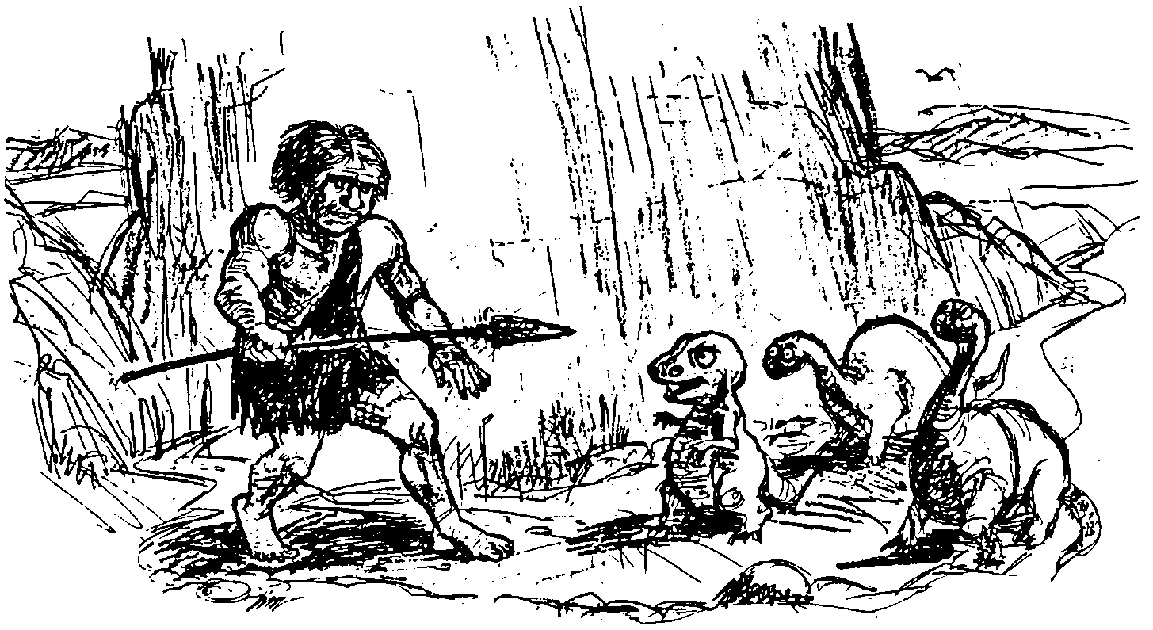
“If You Don’t Actively Attack the Risks,
© USC-CSE
9/15/98

Slide 4
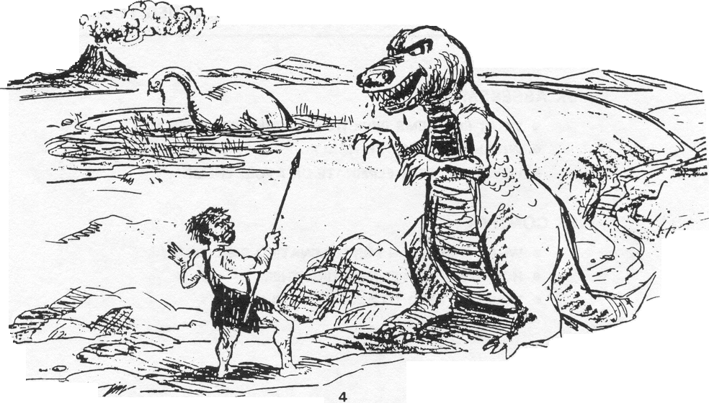
The Risks Will Actively Attack You.”
-Tom Gilb
© USC-CSE
9/15/98

Slide 5
Importance of Risk Management
Addresses Complex Software Systems
Focuses Projects on Critical Risk Items
Provides Techniques for Handling Risk Items
Reduces Software Costs by Reducing Rework
  Usually 40-50% of software costs
© USC-CSE
9/15/98

Slide 6
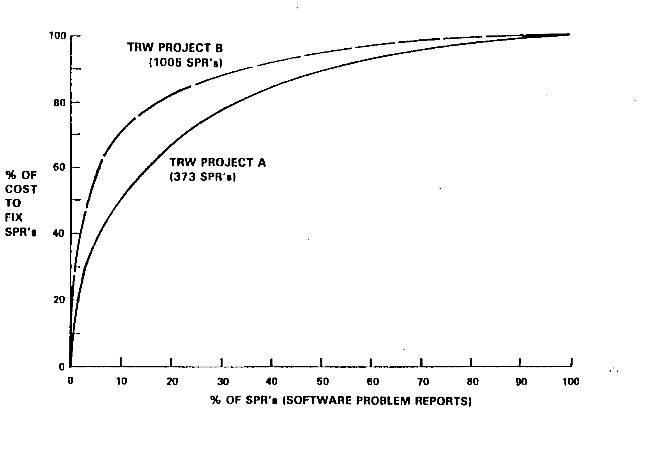
Rework Costs Concentrated in a Few High-Risk Items
© USC-CSE
9/15/98

Slide 7
If Risk Management is so important, why don’t people do it?
Unwillingness to admit risks exist
    Leaves impression that you don’t know exactly what you’re doing
    Leaves impression that your bosses, customers don’t know exactly what they’re doing
    “Success-orientation”
Tendency to postpone the hard parts
    Maybe they’ll go away
    Maybe they’ll get easier, once we do the easy parts
Costs money and time up front
© USC-CSE
9/15/98

Slide 8
When do people do Risk Management?
After they’ve been burned in similar situation
    Pain-avoidance
    Convincing evidence of consequences
When everybody involved is convinced that risks exist, but that it’s still worth going forward
    Everyone is a winner  Realistic expectations
When they’ve learned how to do it well
    Techniques not well-known, but can be learned
© USC-CSE
9/15/98

Slide 9
Defining Risk
“Risk”: Possibility of loss or injury
-Webster
Risk Exposure =
(Probability of unsatisfactory outcome) X
(Loss if unsatisfactory outcome)
© USC-CSE
9/15/98

Slide 10
Components of “Satisfactory Outcome:”
Stakeholder Win Condition Satisfaction
Customer, Developer: Budget, Schedule
User: Functionality, Performance, Reliability, Usability
Maintainer: Modifiability, Portability
Product Line Manager: Reusability
Many Counterexamples:
  Lee, “The Day the Phones Stopped,” 1991
  Gibbs, “Software’s Chronic Crisis,” 1994
  Neumann, “Computer Related Risks,” 1995
© USC-CSE
9/15/98

Slide 11
A Typical Software Risk Situation
Software Controls Spaceborne Experiment
PROB (Software has critical error) = 0.4
Loss from Critical Error Occurring = $20M
If Do Independent V&V:
  PROB (Critical Error Remains) = 0.05
  Added Cost to Software Project = $1M
If No Independent V&V:
  PROB (Critical Error Remains) = 0.2
  Added Cost to Software Project = $0
© USC-CSE
9/15/98

Slide 12
The Fundamental Risk Analysis Paradigm
LOSS = - $1M
FIND CE
p = 0.35
-21M
DO IV&V
DON’T FIND CE
EV = -2
p = 0.05
NO CE
-1M
p = 0.6
0
FIND CE
p = 0.2
DON’T FIND CE
-20
NO IV&V
EV = -4
p = 0.2
NO CE
0
p = 0.6
© USC-CSE
9/15/98

Slide 13
Outline
Risk Management Definitions and Principles
Risk Assessment and Control
  Relations to CS577a Projects
Recommended Implementation Approach
Conclusions
© USC-CSE
9/15/98

Slide 14
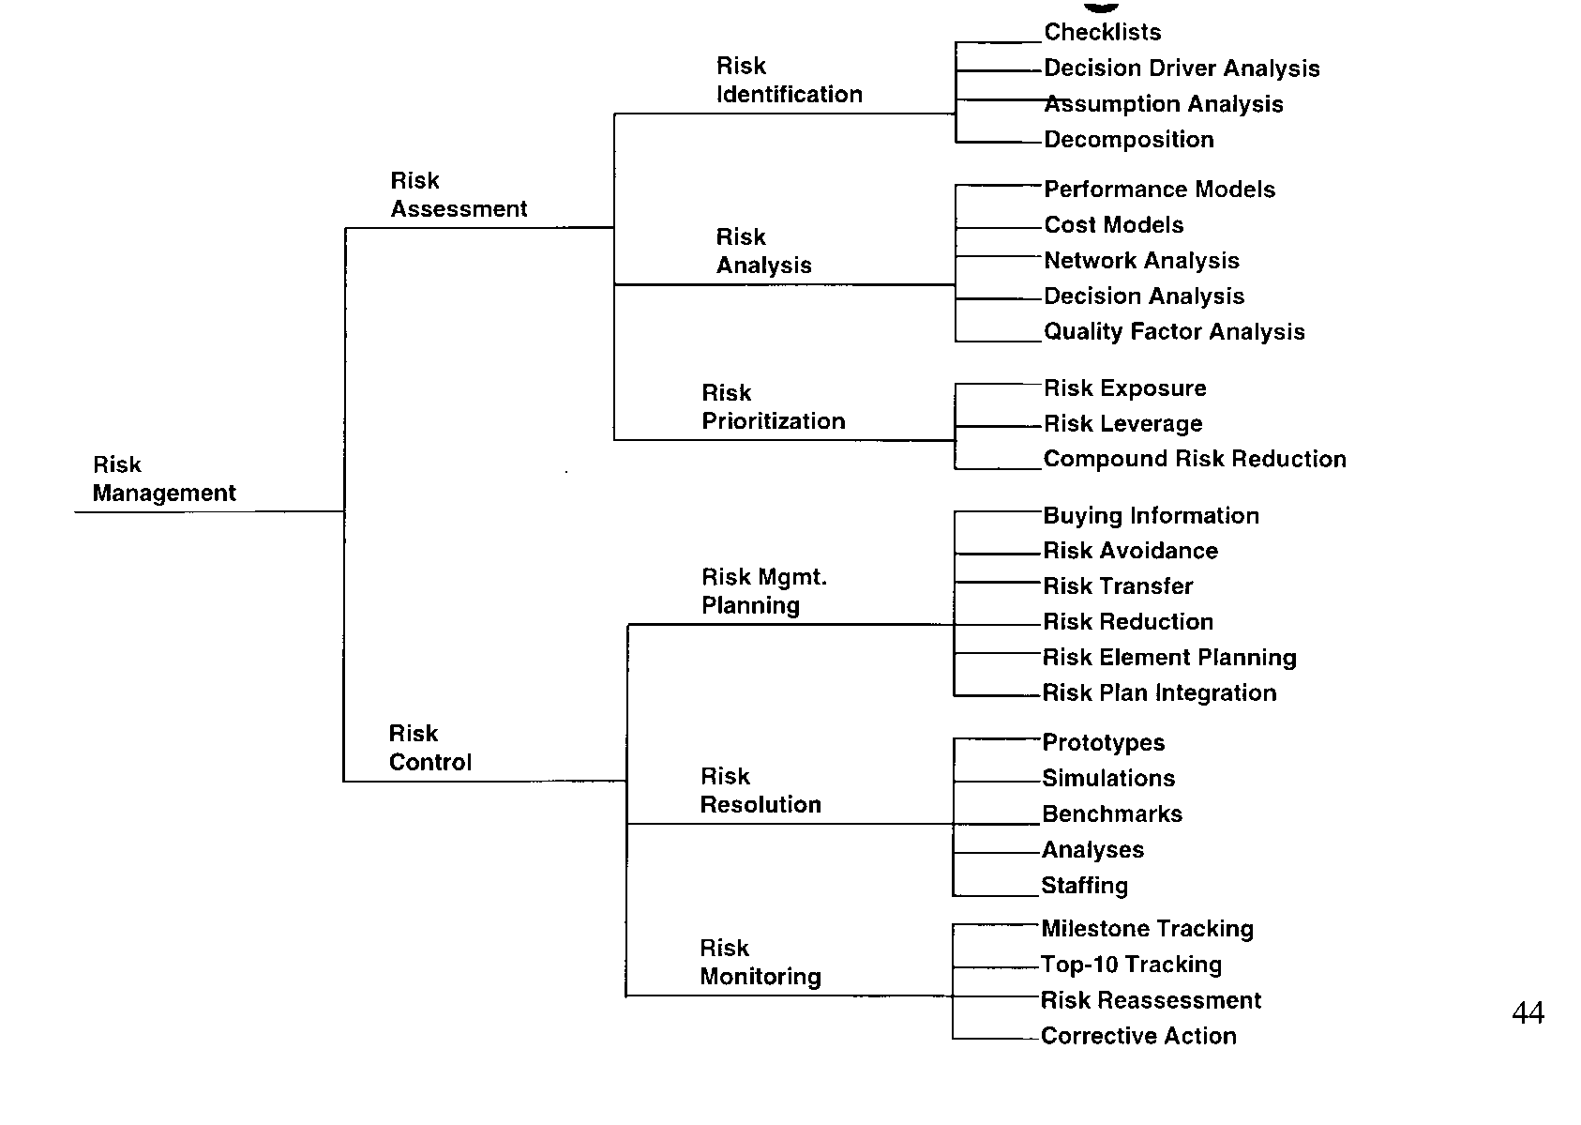
Software Risk Management
© USC-CSE
9/15/98

Slide 15
Top 10 Risk Items: 1989 and 1995
1989
1. Personnel shortfalls
2. Schedules and budgets
3. Wrong software functions
4. Wrong user interface
5. Gold plating
6. Requirements changes
7. Externally-furnished components
8. Externally-performed tasks
9. Real-time performance
10. Straining computer science
1995
1. Personnel shortfalls
2. Schedules, budgets, process
3. COTS, external components
4. Requirements mismatch
5. User interface mismatch
6. Architecture, performance, quality
7. Requirements changes
8. Legacy software
9. Externally-performed tasks
10. Straining computer science
© USC-CSE
9/15/98

Slide 16
Candidate CS577 Risk Items
Personnel: commitment; compatibility; ease of communication; skills (management, Web/Java, Perl, CGI, data compression, …)
Schedule: project scope; IOC content; critical-path items (COTS, platforms, reviews, …)
COTS: see next charts; multi-COTS
Rqts, UI: mismatch to Library user needs
Performance: #bits; #bits/sec; overhead sources
© USC-CSE
9/15/98

Slide 17
COTS and External Component Risks
COTS risks: immaturity; inexperience; COTS incompatibility with application, platform, other COTS; controllability
Non-commercial off-the shelf components: reuse libraries, government, universities, etc.
  Qualification testing; benchmarking; inspections; reference checking; compatibility analysis
© USC-CSE
9/15/98

Slide 18
Advantages of COTS and Custom Software
COTS Integration
Predictable license costs
Broadly used, mature technology
Available now
Dedicated support organization
Hardware/software independence
Rich in functionality
Frequent upgrades
Custom Development
Complete freedom
Smaller, often simpler
Often better performance
Control of development/ enhancement
Control of reliability tradeoffs
© USC-CSE
9/15/98

Slide 19
Disadvantages of COTS and Custom Software
COTS Integration
Up front license fees
Recurring maintenance fees
Dependency on vendor
Efficiency sacrifices
Functionality constraints
Integration not always trivial
No control over upgrades/ maintenance
Unnecessary features consume extra resources
Reliability often unknown/ inadequate
Scale difficult to change
Incompatibilities among vendors
Licensing and intellectual property issues
Custom Development
Development expensive/unpredictable
Availability date unpredictable
Maintenance expensive
Portability often expensive
Drains expert resources
© USC-CSE
9/15/98

Slide 20
The Top Ten Software Risk Items
Risk Item
Risk Management Techniques
1. Personnel Shortfalls
Staffing with top talent; key personnel
agreements; incentives; team-building; training;
tailoring process to skill mix; peer reviews
2. Unrealistic schedules
and budgets
Business case analysis; design to cost; incremental
development; software reuse; requirements descoping;
adding more budget and schedule
3. COTS; external components
Qualification testing; benchmarking; prototyping; reference checking; compatibility analysis; vendor analysis; evolution support analysis
4. Requirements mismatch;
gold plating
Stakeholder win-win negotiation; business case
analysis; mission analysis; ops-concept formulation;
user surveys; prototyping; early users’ manual;
design/develop to cost
5. User interface mismatch
Prototyping; scenarios; user characterization
(functionality, style, workload)
© USC-CSE
9/15/98

Slide 21
The Top Ten Software Risk Items (Concluded)
6. Architecture, performance,
quality
Architecture tradeoff analysis and review boards;
simulation; benchmarking; modeling; prototyping;
instrumentation; tuning
7. Requirements changes
High change threshold; information
hiding; incremental development (defer
changes to later increments)
8. Legacy software
Design recovery; phaseout options analysis;
wrappers/mediators; restructuring
9. Externally-performed
tasks
Reference checking; pre-award audits;
award-fee contracts; competitive design
or prototyping; team-building
10. Straining Computer
Science capabilities
Technical analysis; cost-benefit analysis;
prototyping; reference checking
© USC-CSE
9/15/98

Slide 22
SEI Risk Taxonomy for Risk Identification
-CMU/SEI-93-TR-06
Software Development Risk
Product
Engineering
Development
Environment
Program
Constraints
Class
Element
Requirements * * *
Engineering
Specialties
Development * * * Work
Process Environment
Resources
Attribute
Stability * * * Scale
Formality * * * Product
Control
Schedule * * * Facilities
© USC-CSE
9/15/98

Slide 23
SEI Risk Taxonomy: Sample Questions
Class
A. Product Engineering
Element
2. Design
Attribute
c. Performance
Starter
Question
[22] Has a performance analysis been done?
(Yes) (22.a) What is your confidence in the performance analysis?
(Yes) (22.b) Do you have a model to track performance through
design and implementation?
Follow-up
Questions
Starter
Question
[23] Are there any problems with performance?
throughput
scheduling asynchronous real-time events
real-time response
recovery time lines
database response, contention, or access
Cues
© USC-CSE
9/15/98

Slide 24
SEI Risk Taxonomy: Lessons Learned
Taxonomy-based questionnaire works
Group of 5 to interview is maximum
Important to have peer group in interviews
2-1/2 hour interview is sufficient
Interview protocol is important
  allow risk discussions to proceed naturally
  use non-judgmental questions and probes
© USC-CSE
9/15/98

Slide 25
Prioritizing Risks: Risk Exposure
Risk Exposure - (Probability) (Loss of Utility)
High
Check
Utility -
Loss Estimate
Major
Risk
Risk Probability
Check
Probability
Estimate
Little
Risk
Low
Low
© USC-CSE
High
9/15/98
Loss of Utility

Slide 26
Risk Exposure Factors
(Satellite Experiment Software)
Unsatisfactory Outcome (UO)
Prob (UO)
Loss (UO)
Risk Exposure
3 - 5
3 - 5
4 - 8
5
5
6
8
6
1
2
10
8
7
9
3
4
1
5
7
2
30 - 50
24 - 40
28 - 56
45
15
24
8
30
7
4
A. S/ W error kills experiment
B. S/ W error loses key data
C. Fault tolerance features cause unacceptable
performance
D. Monitoring software reports unsafe condition
as safe
E. Monitoring software reports safe condition
as unsafe
F. Hardware delay causes schedule overrun
G. Data reduction software errors cause extra
work
H. Poor user interface causes inefficient
operation
I. Processor memory insufficient
J. DBMS software loses derived data
© USC-CSE
9/15/98

Slide 27
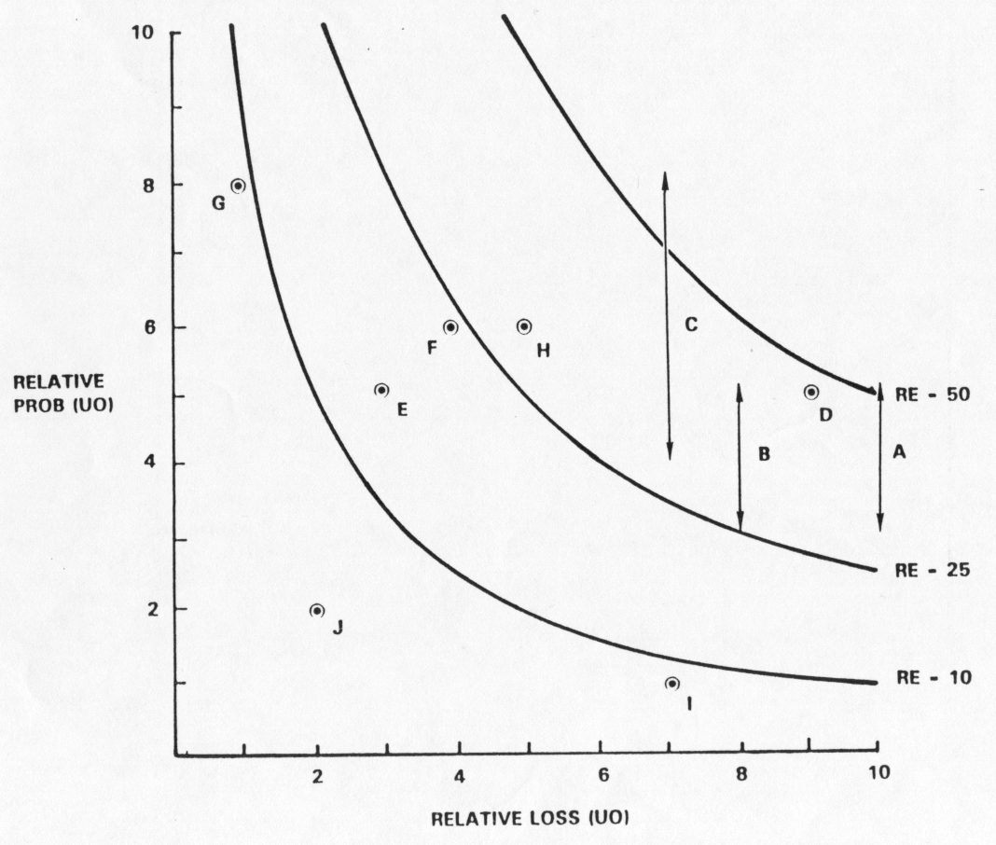
Risk Exposure Factors and Contours: Satellite Experiment Software
© USC-CSE
9/15/98

Slide 28
Risk Reduction Leverage (RRL)
RRL -
RE
BEFORE -
RE
AFTER
RISK REDUCTION COST
Spacecraft Example
LONG DURATION
TEST
FAILURE MODE
TESTS
LOSS (UO)
PROB (UO)
RE
$20M
0.2
$4M
$20M
0.2
$4M
B
B
PROB (UO)
RE
0.05
$1M
0.07
$1.4M
A
A
COST
$2M
$0.26M
4-1
4- 1.4
RRL
= 1.5
= 10
2
0.26
© USC-CSE
9/15/98

Slide 29
Software Risk Management
© USC-CSE
9/15/98

Slide 30
Risk Management Plans
For Each Risk Item, Answer the Following Questions:
1. Why?
Risk Item Importance, Relation to Project Objectives
2. What, When?
Risk Resolution Deliverables, Milestones, Activity Nets
3. Who, Where?
Responsibilities, Organization
4. How?
Approach (Prototypes, Surveys, Models, …)
5. How Much?
Resources (Budget, Schedule, Key Personnel)
© USC-CSE
9/15/98

Slide 31
Risk Management Plan: Fault Tolerance Prototyping
1. Objectives (The “Why”)
  Determine, reduce level of risk of the software fault tolerance features causing unacceptable performance
  Create a description of and a development plan for a set of low-risk fault tolerance features
2. Deliverables and Milestones (The “What” and “When”)
  By week 3
    1. Evaluation of fault tolerance option
    2. Assessment of reusable components
    3. Draft workload characterization
    4. Evaluation plan for prototype exercise
    5. Description of prototype
  By week 7
    6. Operational prototype with key fault tolerance features
    7. Workload simulation
    8. Instrumentation and data reduction capabilities
    9. Draft Description, plan for fault tolerance features
  By week 10
    10. Evaluation and iteration of prototype
    11. Revised description, plan for fault tolerance features
© USC-CSE
9/15/98

Slide 32
Risk Management Plan: Fault Tolerance Prototyping (concluded)
Responsibilities (The “Who” and “Where”)
  System Engineer: G. Smith
    Tasks 1, 3, 4, 9, 11, support of tasks 5, 10
  Lead Programmer: C. Lee
    Tasks 5, 6, 7, 10 support of tasks 1, 3
  Programmer: J. Wilson
    Tasks 2, 8, support of tasks 5, 6, 7, 10
Approach (The “How”)
  Design-to-Schedule prototyping effort
  Driven by hypotheses about fault tolerance-performance effects
  Use real-time OS, add prototype fault tolerance features
  Evaluate performance with respect to representative workload
  Refine Prototype based on results observed
Resources (The “How Much”)
  $60K - Full-time system engineer, lead programmer, programmer (10 weeks)*(3 staff)*($2K/staff-week)
  $0K - 3 Dedicated workstations (from project pool)
  $0K - 2 Target processors (from project pool)
  $0K - 1 Test co-processor (from project pool)
  $10K - Contingencies
  $70K - Total
© USC-CSE
9/15/98

Slide 33
Risk Monitoring
Milestone Tracking
  Monitoring of risk Management Plan Milestones
Top-10 Risk Item Tracking
  Identify Top-10 risk items
  Highlight these in monthly project reviews
  Focus on new entries, slow-progress items
  Focus review on manger-priority items
Risk Reassessment
Corrective Action
© USC-CSE
9/15/98

Slide 34
Project Top 10 Risk Item List: Satellite Experiment Software
Mo. Ranking
This Last #Mo.
Risk Item
Risk Resolution Progress
Replacing Sensor-Control Software 1 4 2 Top Replacement Candidate Unavailable
Developer
Target Hardware Delivery Delays 2 5 2 Procurement Procedural Delays
Sensor Data Formats Undefined 3 3 3 Action Items to Software, Sensor Teams;
Due Next Month
Staffing of Design V&V Team 4 2 3 Key Reviewers Committed; Need Fault-
Tolerance Reviewer
Software Fault-Tolerance May 5 1 3 Fault Tolerance Prototype Successful
Compromise Performance
Accommodate Changes in Data 6 - 1 Meeting Scheduled With Data Bus
Bus Design Designers
Testbed Interface Definitions 7 8 3 Some Delays in Action Items; Review
Meeting Scheduled
User Interface Uncertainties 8 6 3 User Interface Prototype Successful
TBDs In Experiment Operational - 7 3 TBDs Resolved
Concept
Uncertainties In Reusable - 9 3 Required Design Changes Small,
Monitoring Software Successfully Made
© USC-CSE
9/15/98

Slide 35
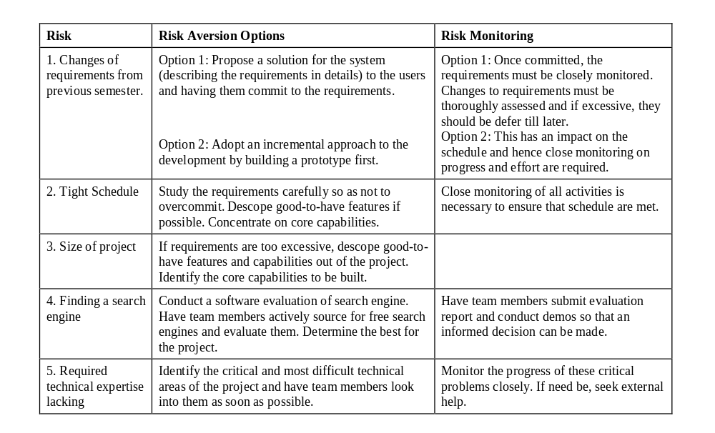
Example Top-N Risk Item List
© USC-CSE
9/15/98

Slide 36
Recommended Implementation Approach Incremental Evolution
1. Establish top-10 risk item tracking process
  Simple; inexpensive; gets early results
2a. Experimentally apply selected risk mgmt. Techniques
  SEI Risk Taxonomy; risk assessment tools
2b. Develop, apply risk mgmt. Plan on initial project
3a. Extend risk assessment and control to all projects
3b. Experimentally apply advanced risk mgmt.
4. Evolve the mapping of best risk management techniques to your project situations
© USC-CSE
9/15/98

Slide 37
Conclusions
Risk Management is a good match for complex software projects
  Avoiding software surprises, show-stoppers
  Reducing costs
Proven risk management techniques are available
Risk management is not a cookbook approach
© USC-CSE
9/15/98

